Slide 1
Service Member
How To Guide for State TA
2 June 2026

Slide 2
STA Overview
Before applying for STA, any available FTA needs to be exhausted
  Army apply online via Army IgnitED
  Air Force apply online via AFVEC
Application window
  Apply as early as 60 days prior to the start date of class
  Application must be submitted no later than 8 days prior to the start date of class
STA can pay towards up to the following
  Fall semester: 15 credit hours
  Summer semester: 9 credit hours
  Spring semester: 15 credit hours

Slide 3
Dates you need to know
Date of enlistment/appointment
  Date you joined the Guard
  Must be before class start date
ETS (Expiration Term of Service)
  Date you may leave the Guard
  Must be after class end date
Year/semester last applied for STA
  Can estimate if unsure
Course start/end dates
  This will be on your course schedule

Slide 4
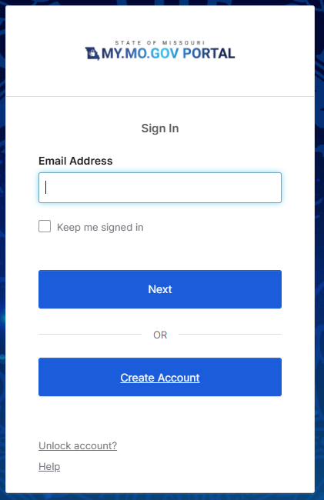
Log in to the STA website
https://apps1.mo.gov/MONGSTA
If you have an account, input your email address and click “Next”
  Then go to slide 9
If you do not have an account, click “Create Account”

Slide 5
OKTA How To
The first time you apply you will need to set up an account with OKTA
Your OKTA password will not expire
Use a personal email that you will always have access too
If you have an OKTA account, skip to slide 9

Slide 6
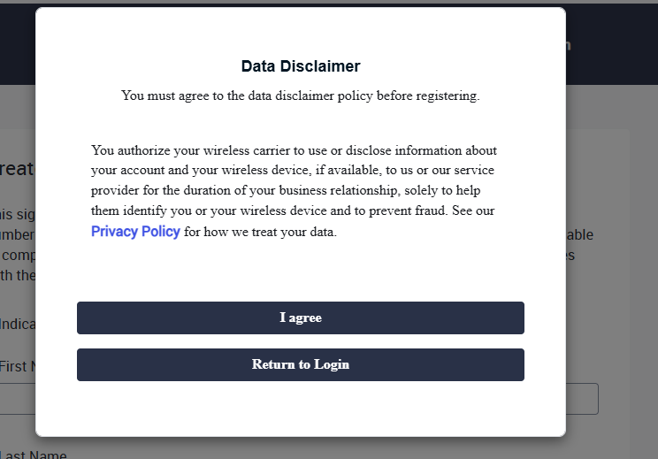
Click “I agree”

Slide 7
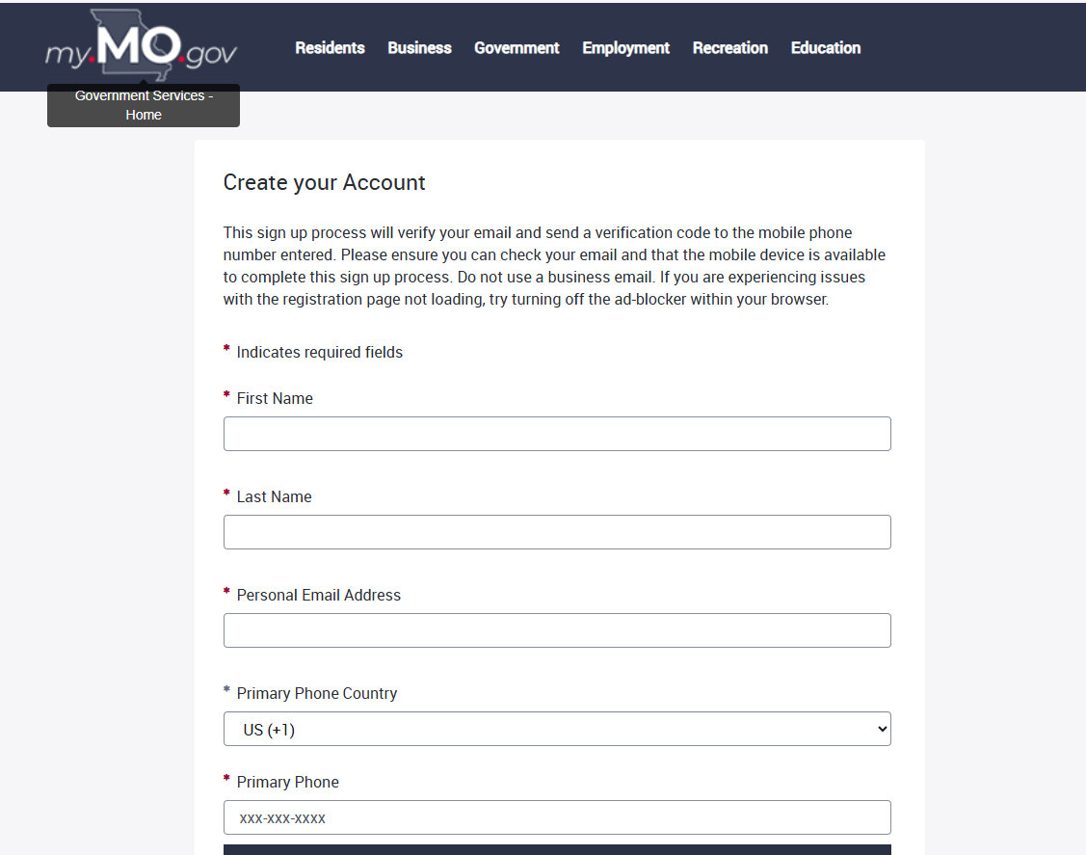
Account Setup
Fill out the requested details
Use a personal email address (not military or school)
Write down the password you create
Once all boxes are filled, click “Create Your Account” at the bottom

Slide 8
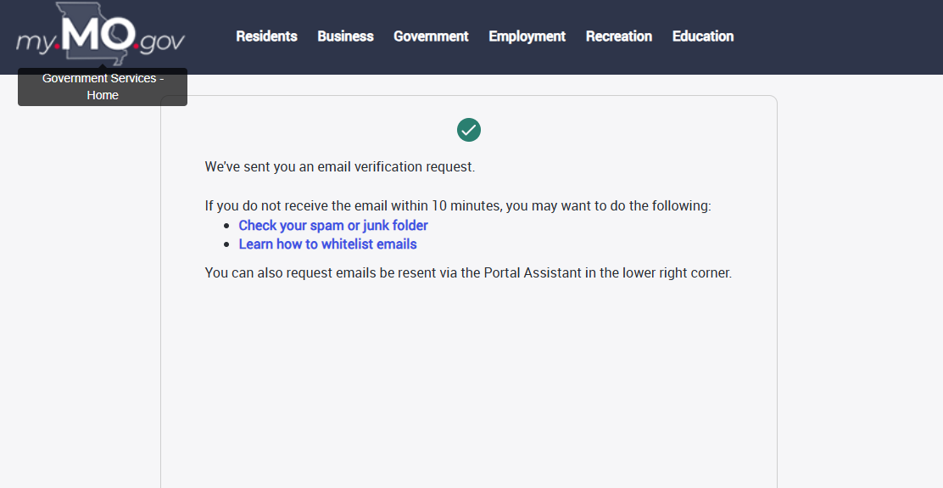
Account Setup continued
Once you receive this message, log out and go to the personal email you had listed

Slide 9
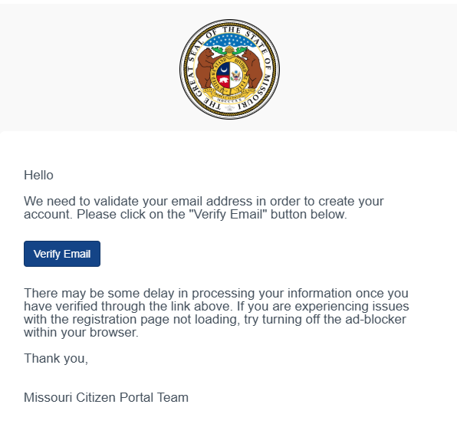
Account Setup
You will receive an email
Click “Verify Email”

Slide 10
State Tuition Assistance Website
Navigate to https://apps1.mo.gov/MONGSTA
Log in with your OKTA account details
Apply each semester
  Separate applications needed if attending more than one school

Slide 11
STA Required Documents

Slide 12
Acknowledgment and Acceptance Form
Read, review, and sign the STA Acknowledgment and Acceptance Form
Then click “Next”

Slide 13
Tuition and Fees Waiver
Applicant must complete the application in its entirety
Select OPT-IN, OPT-OUT, or Undecided for the Waiver
  To be eligible for the Wavier, SMs must meet the following requirements:
    Attending a Missouri public school
    Federal TA exhausted
    State TA exhausted
    Financial Aid (Pell Grant, etc), if awarded, exhausted
    External scholarships, if awarded, exhausted
    Each school will determine applicable amount to be waived, if any

Slide 14
Have your course schedule available before hitting "Add Course”
It is important that the information you input matches your course schedule

Slide 15
Input your course information. This needs to match your course schedule.
*see below notes
*Course Code will be the Course Prefix such as ENG 101.
*Course Name will be the Course Title such as English Composition.

Slide 16
Continue to add courses until all your courses show here
  Once all courses are listed, click “Next”
Be sure to verify all information against your course schedule and itemized bill

Slide 17
Document Upload
You will then upload all required documents
Examples are available on Teams
  Reach out to your unit for assistance

Slide 18
Free Application for Financial Student Aid
Login to FAFSA at https://studentaid.gov/ and complete an application
FAFSA must be completed for each academic year to receive State TA IAW Missouri law. (Academic Year Fall – Spring, e.g., Fall 2026-Spring 2027)
Proof of FAFSA must include name of applicant, academic year, and that the application was processed
A FAFSA Submission Summary will contain all the required information
We only need the 1st page of the Submission Summary

Slide 19
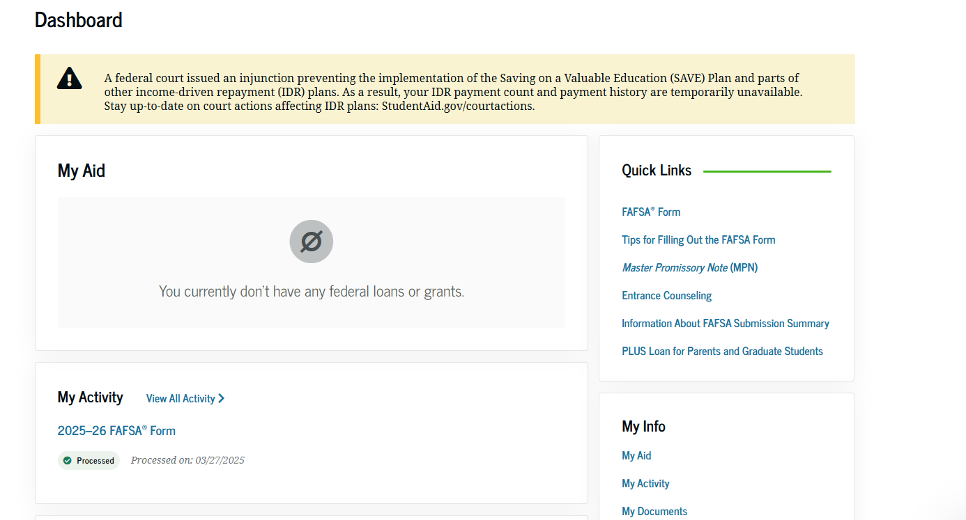
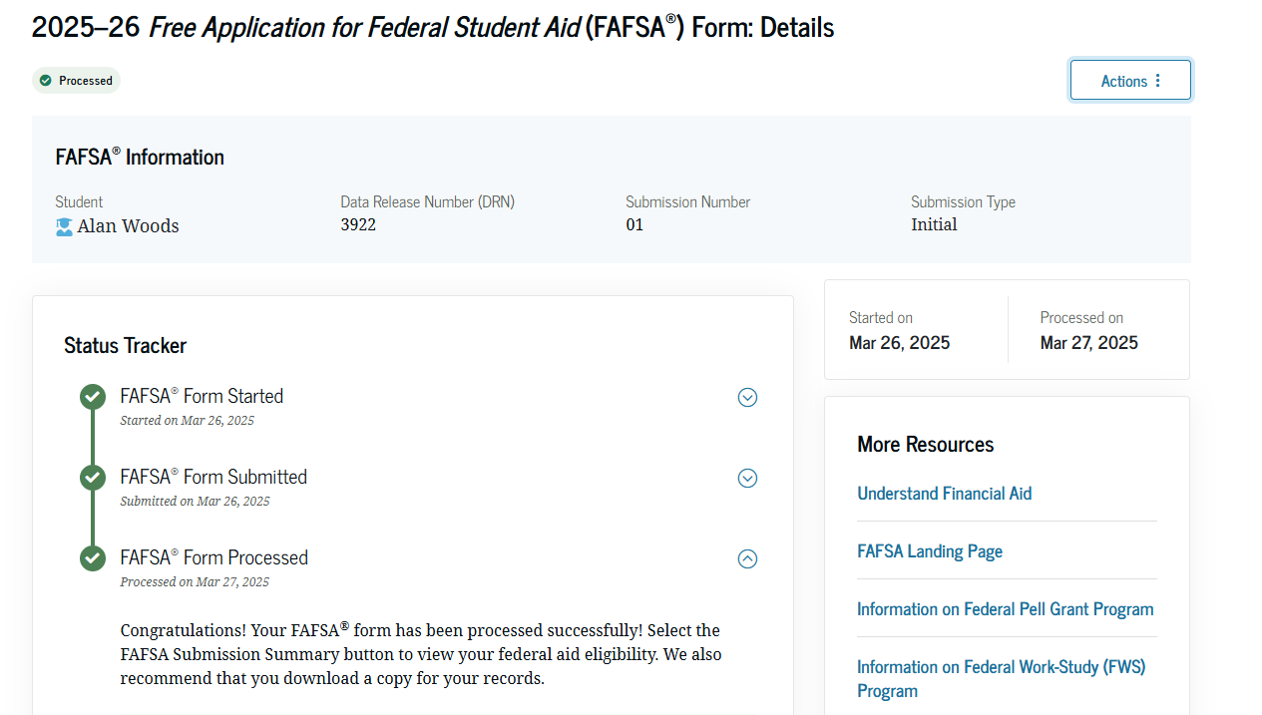
How to Print FAFSA Submission Summary
Once logged in, from dashboard, scroll down to “My Activity”
Click on the correct Academic Term, “2026-27 FAFSA Form”
Print the page

Slide 20
Course Schedule
Course schedules must contain the following information:
  Applicants Name
  School’s Name
  Course Title(s)
  Credit hours per course
  Start and end dates per course
  Must be in PDF format
Contact your school’s Veterans Center for assistance with required documents
Your unit has access to examples are located on the MO Education and Incentives TEAMS channel

Slide 21
Itemized Bill
Itemized bill must contain the following information:
  Applicants Name
  School’s Name
  Clearly show the cost of tuition
  Clearly show the cost of any fees
Contact your school’s Veterans Center for assistance with required documents
Your unit has access to examples are located on the MO Education and Incentives TEAMS channel

Slide 22
Commander’s Letter
Template is available on Teams and the MO Guard website
  https://www.moguard.ngb.mil/Programs/Education-and-Incentives/

Slide 23
Transcripts
Transcripts can be official or unofficial, but they must contain the following information:
  Applicants Name
  School’s Name
  All Grades
  Cumulative GPA
  Must be in PDF format
Missouri law requires a 2.5 cumulative GPA to be eligible for State TA
Contact your school’s Veterans Center for assistance with required documents

Slide 24
Once submitted, you will be able to see the status of the request on the STA Website
Ensure all details are accurate

Slide 25
Messages
If you have any questions, use the messaging system in the STA Website
  Be sure to check back for any responses

Slide 26
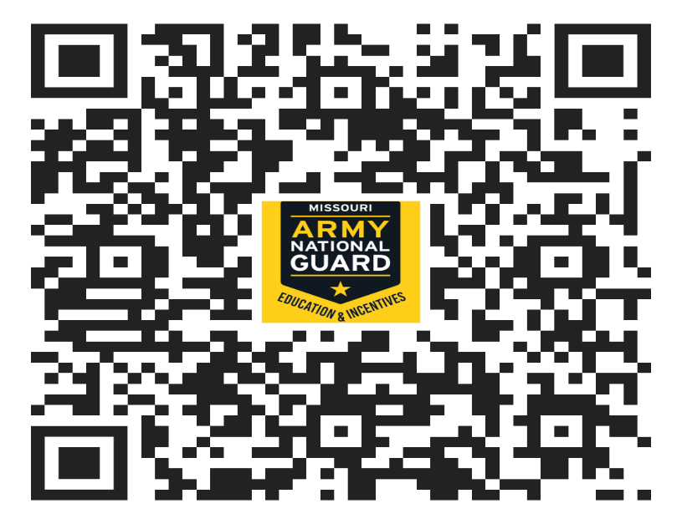
Questions
You can always contact the Education and Incentives Office if you need assistance or have questions about your education benefits or incentives.
Army State TA: ng.mo.moarng.mbx.per-inc-stateta@army.mil
Army Incentives: ng.mo.moarng.mbx.per-incentives@army.mil
Air State TA: ng.mo.moang.mbx.ang-ta-mail@army.mil
Call 573-638-9500 ext. 37053

